Slide 1
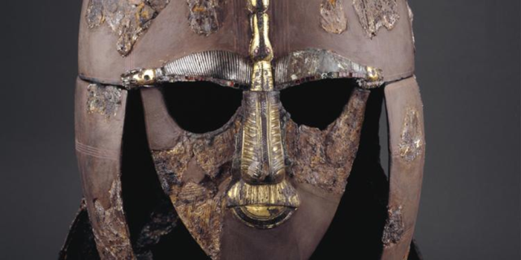
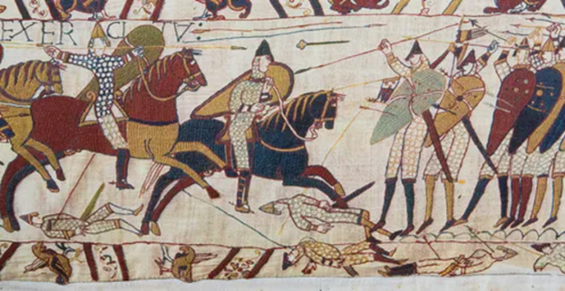
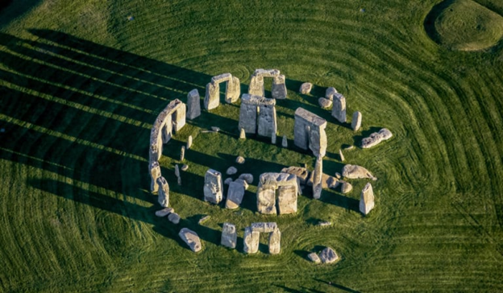
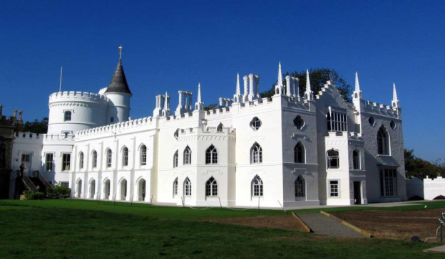
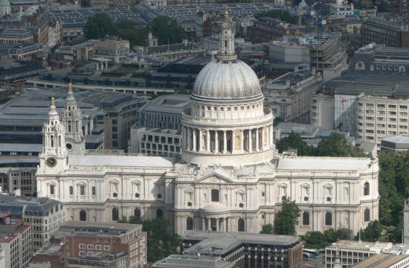
Country Studies: Anglo-Saxon Culture
Natália Bányász, PhD, Associate professor

Slide 2
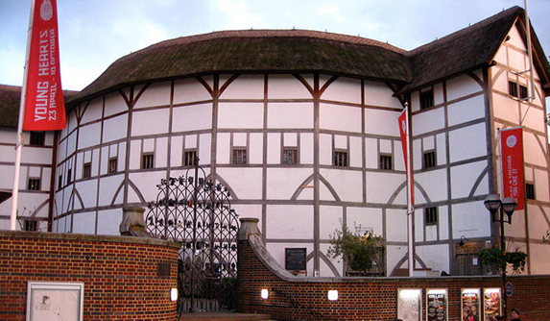
Course Outline
Course Type: optional course
Number of ECTS credits: 4
Lectures: 16
Seminars: 30
Independent study: 74

Slide 3
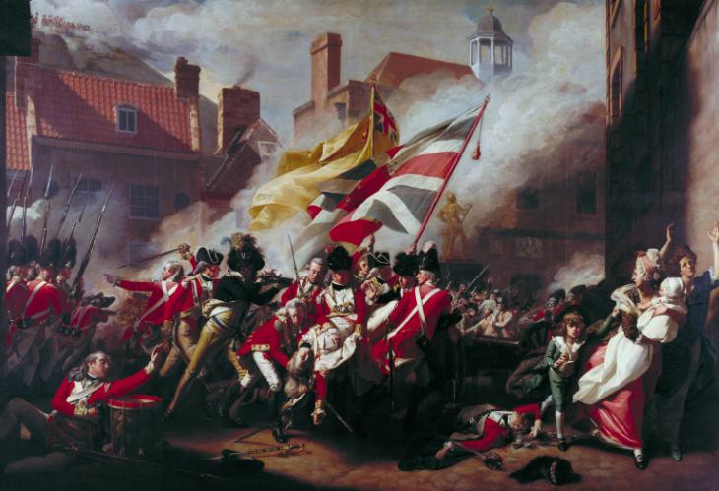
Aim of the Course
increase cultural understanding and tolerance by learning about societies and cultures
increase the cultural awareness of different art movements
better understanding of the historical background of arts and its effect on today’s society
understanding the past and present art movements of the UK

Slide 4
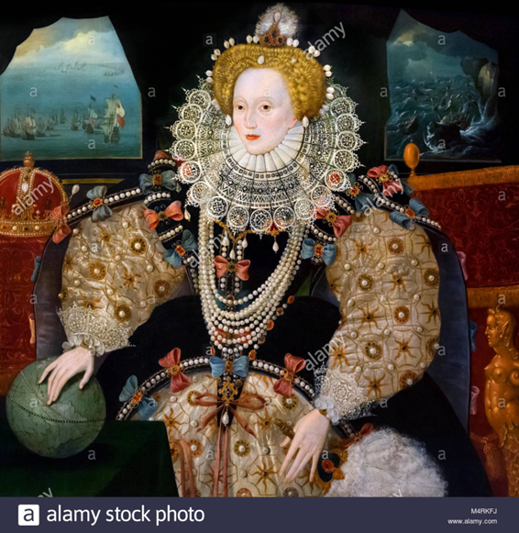
Main topics
Becoming British. British cultural life
British cuisine
The ‘Celtic countries’
Performing arts
British Popular Music
British fashion
British films

Slide 5
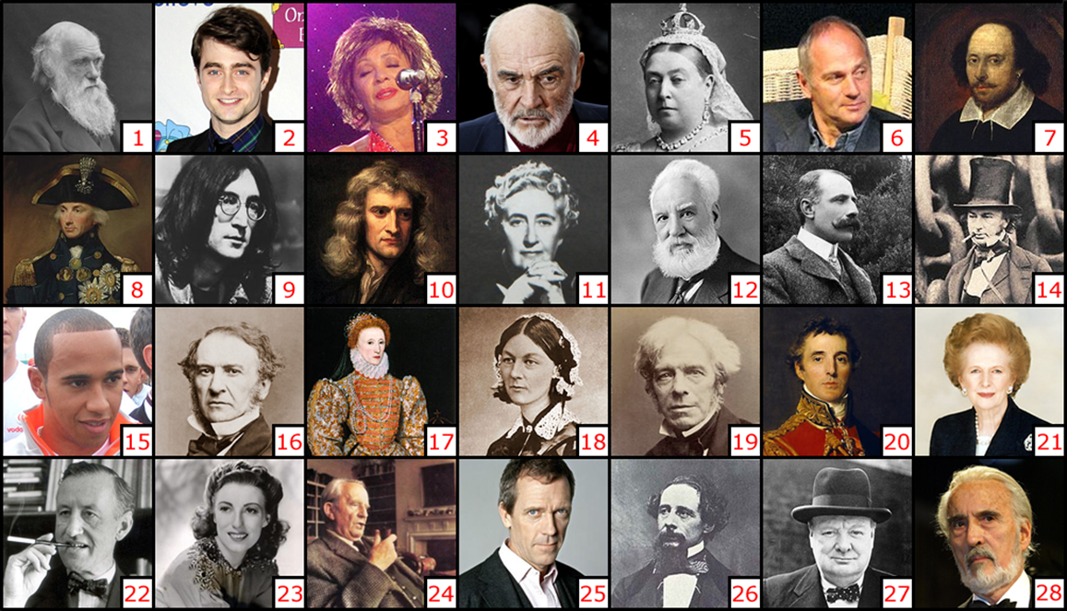
Famous British People

