Slide 1
Country Studies: Beginnings of modern Britain
The Real Tudors

Slide 2
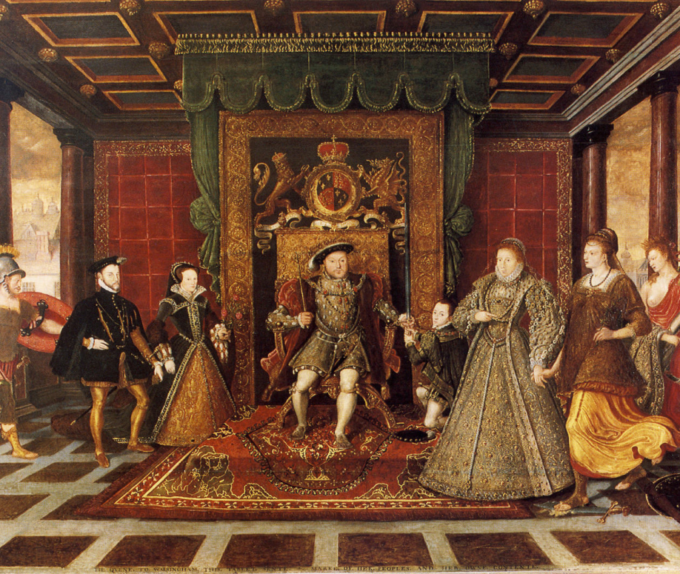
Course outline
Course Type: optional course
Number of ECTS credits: 4
Lectures: 10
Seminars: 20
Independent study: 90

Slide 3
Aim of the Course
increase cultural understanding and tolerance by learning about societies and cultures
students will gain a working knowledge of the main events of the Tudor Era and their chronological order.
students will become familiar with the individuals who played an important role in the Tudor Era.
understand the past and present of Britain

Slide 4
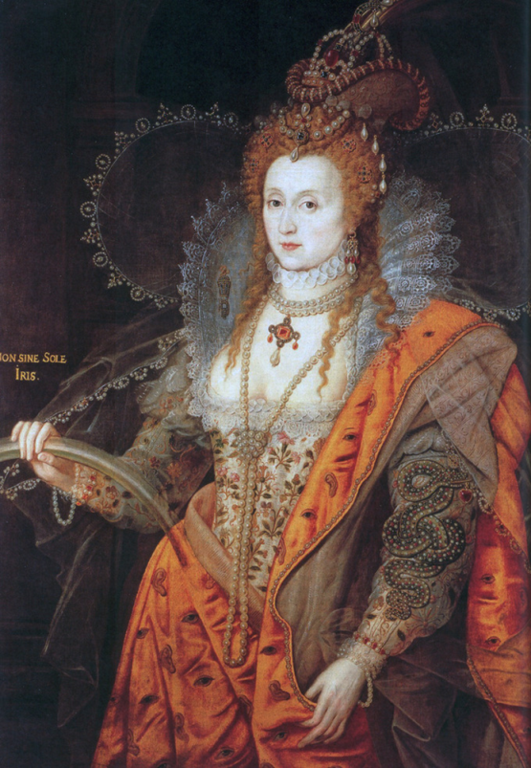
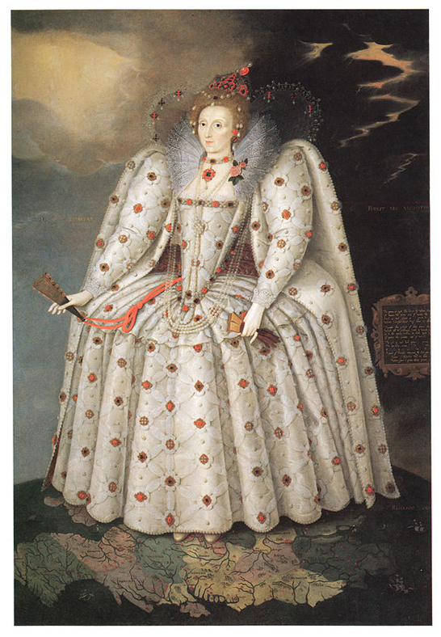
Tudor ART:pORTAITS

Slide 5
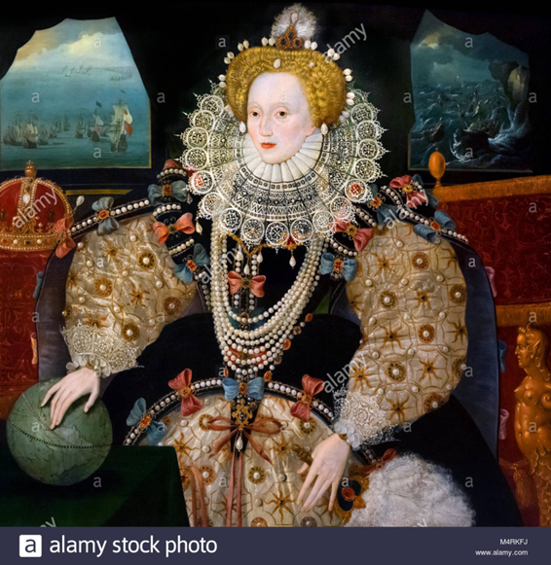
Tudor ART:pORTAITS

Slide 6
Main Topics
The Tudors and the Wars of the Roses
Reign of Henry VII. Beginning of Henry VIII's reign.
The Dissolution of the Monasteries
Tudor Art. Characteristics of Tudor Art
Architecture, Portraiture, Tapestries, Painting
The Elizabethan Period. The Court of Queen Elizabeth I.
Queen Elizabeth and the Arts
The Globe Theatre
The Elizabethan England
Decorative Art in the Tudor Era

Slide 7
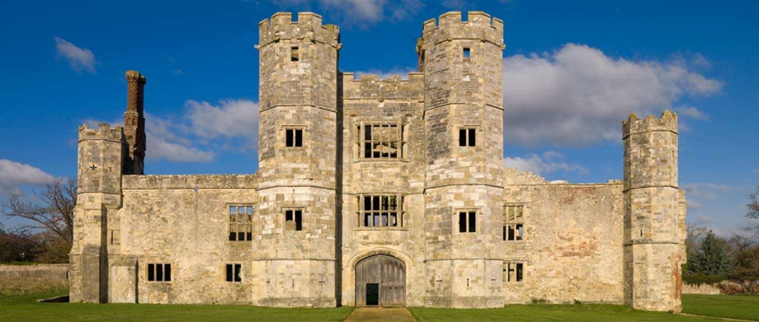
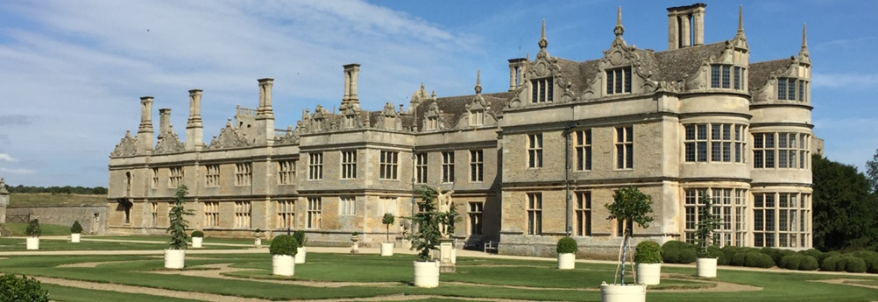
Tudor:Architecture

